Slide 1
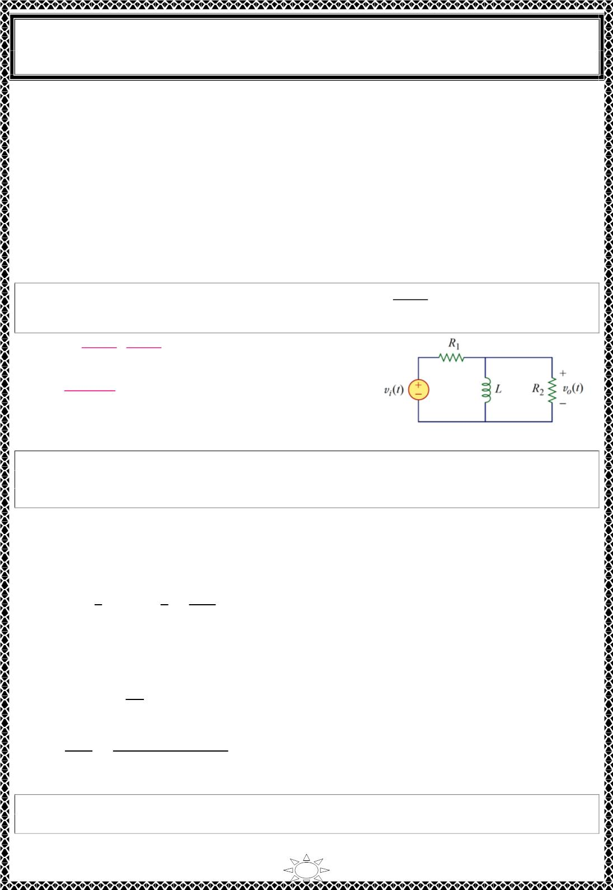
University of Diyala
Engineering College
Electronic Department
Electrical Circuits
2nd Class
Lecturer : Wisam N. AL-Obaidi
Year (2015-2016)
2 = (1 − 휔ꢀ4 × 10^{ꢁ6})ꢀ + (휔 10^{ꢁ3})ꢀ
푐
푐
Assuming that 휔_{푐} is in 푘푟푎푑/푠,
2 = (1 − 4휔ꢀ)ꢀ + 휔ꢀ
or
푐
푐
1ꢂ휔^{ꢃ} − 7휔ꢀ − 1 = 0
푐
푐
ꢀ
휔_{푐}ꢀ = 0 ∙ 5509푎푛푑 − 0 ∙ 11ꢄ4.
Solving the quadratic equation in 휔 , we get
Since 휔 is
푐
real,
푐
휔_{푐} = 0 ∙ 742 krad /푠 = 742 rad /푠
^{푽}_{푶} (흎)
H.W.1: For the circuit shown, obtain the transfer function
. Identify the type of
푽 (흎)
풊
filter and determine the corner frequency. Take R = 100 Ω = R , L = 2 mH.
Answer:
^{푹}ퟐ
(
풋흎
) , highpass filter
1
2
푹_{ퟏ}ꢅ푹_{ퟐ} 풋흎ꢅ흎_{풄}
푹 푹
흎_{풄} =
ퟏ
ퟐ
= ퟐퟓ krad /풔.
(푹 ꢅ푹 )푳
ퟏ
ퟐ
Trail Version
Trail Version
Trail Version
Trail Version
Trail Version
Trail Version
Trail Version
Trail Version
Trail Version
Trail Version
Trail Version
Trail Version
Trail Version
Example 2: If the bandstop filter in Fig.2.8 is to reject a 200-Hz sinusoid while passing
other frequencies, calculate the values of L and C. Take R = 150 Ω and the bandwidth as
100 Hz.
Solution:
We use the formulas for a series resonant circuit
퐵 = 2휋(100) = 200휋푟푎푑/푠
푅
푅
ꢈꢉꢊ
But 퐵 = ⇒ ꢆ = =
= 0 ∙ 2ꢄ87퐻
퐿
ꢇ
ꢀꢊꢊꢋ
Rejection of the 200‐Hz sinusoid means that 푓 is 200 Hz, so that 휔 in is
ꢊ
ꢊ
휔 = 2휋푓 = 2휋(200) = 400휋
ꢊ
ꢊ
Since 휔_{ꢊ} = 1/√ꢆ퐶,
∴ 퐶 =
1
=
1
= 2 ∙ ꢂ5ꢄ휇퐹
휔_{ꢊ}ꢀꢆ (400휋)ꢀ(0.2ꢄ87)
H.W.2: Design a bandpass filter of the form in Fig.2.6 with a lower cutoff frequency of
20.1 kHz and an upper cutoff frequency of 20.3 kHz. Take R = 20 kΩ Calculate L, C & Q.
Answer: 15.92 H, 3.9 pF, 101.
8

Slide 2
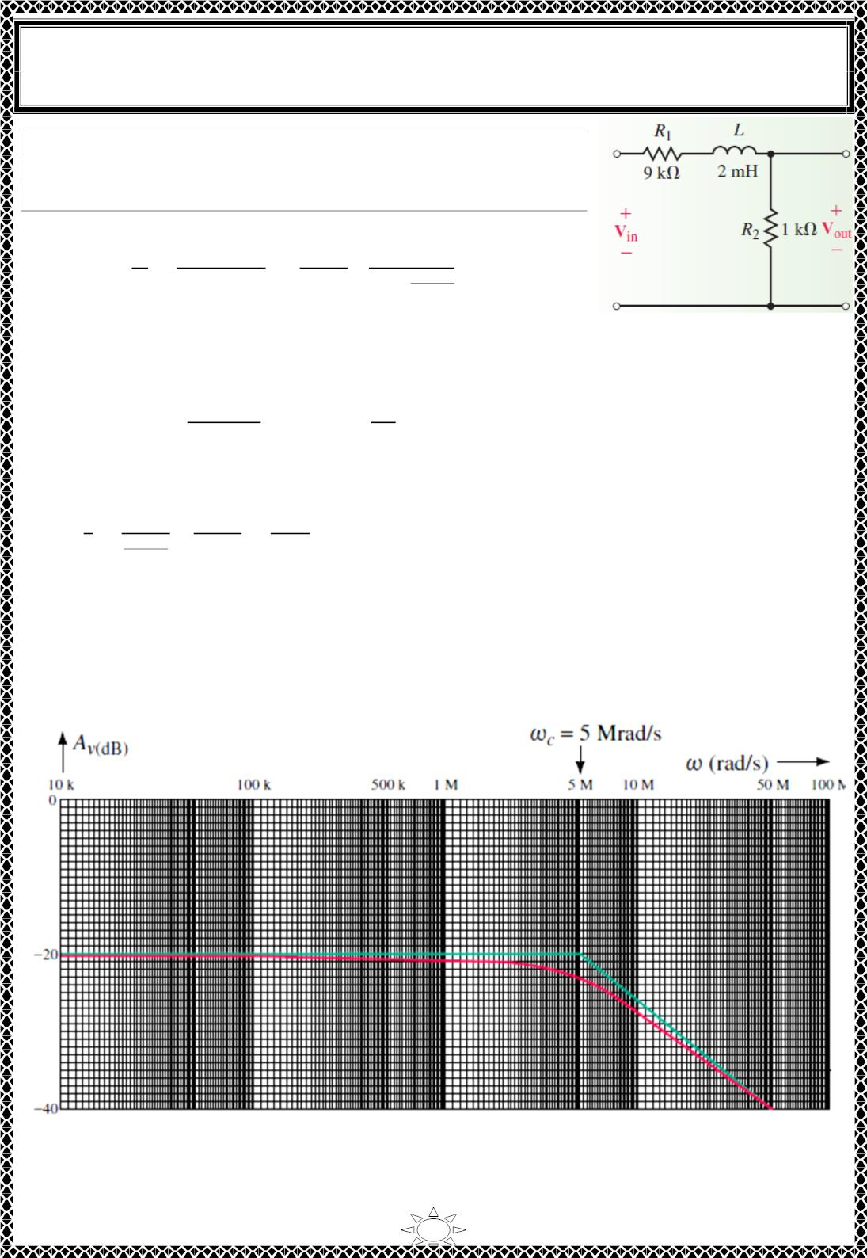
University of Diyala
Engineering College
Electronic Department
Electrical Circuits
2nd Class
Lecturer : Wisam N. AL-Obaidi
Year (2015-2016)
Example : Consider the low-pass circuit of Figure below.
a. Write the transfer function for the circuit.
b. Sketch the frequency response.
Solution:
푉
^{푅}2
^{푅}2
푅₂+푅₁
ꢂ
표
a. 퐻(휔) =
=
=
ꢁ
ꢃ
ꢅꢄ
ꢆ
푉
푠
푅 +푅 +푗ꢀ퐿
ꢂ+푗ꢀ_{ꢄ}
2
1
2
1
푏. From the transfer function of part (a), we see that the dc gain will no longer be 1 (푂푑퐵)
but rather is found as
퐴_{푣(ꢇ푐)} = ꢈ0 log (
ꢉ_{ꢊ}
ꢉ_{ꢂ} ꢋ ꢉ_{ꢊ}
ꢌ
) = ꢈ0 log ( ) = −ꢈ0푑퐵
ꢌ0
The cutoff frequency occurs at
ꢂ
ꢂ
ꢃ
ꢅꢄ
^{푅}1^{+푅}
ꢂꢍ푘훺
ꢊ푚ꢎ
휔 = =
=
2
=
= 5.0푀푟푎푑/ꢏ
푐
휏
ꢄ
퐿
1
2
Trail Version
Trail Version
Trail Version
Trail Version
Trail Version
Trail Version
Trail Version
Trail Version
Trail Version
Trail Version
Trail Version
Trail Version
Trail Version
The resulting Bode plot is shown in Figure 22‐24. Notice that the frequency response of
the phase shift is precisely the same as for other low‐pass filters. However, the response of
the voltage gain now starts at−20 푑퐵 and then drops at a rate of−20 푑퐵/decade above the
cutoff frequency, 휔_{푐} = 5푀푟푎푑/ꢏ.
9

Slide 3
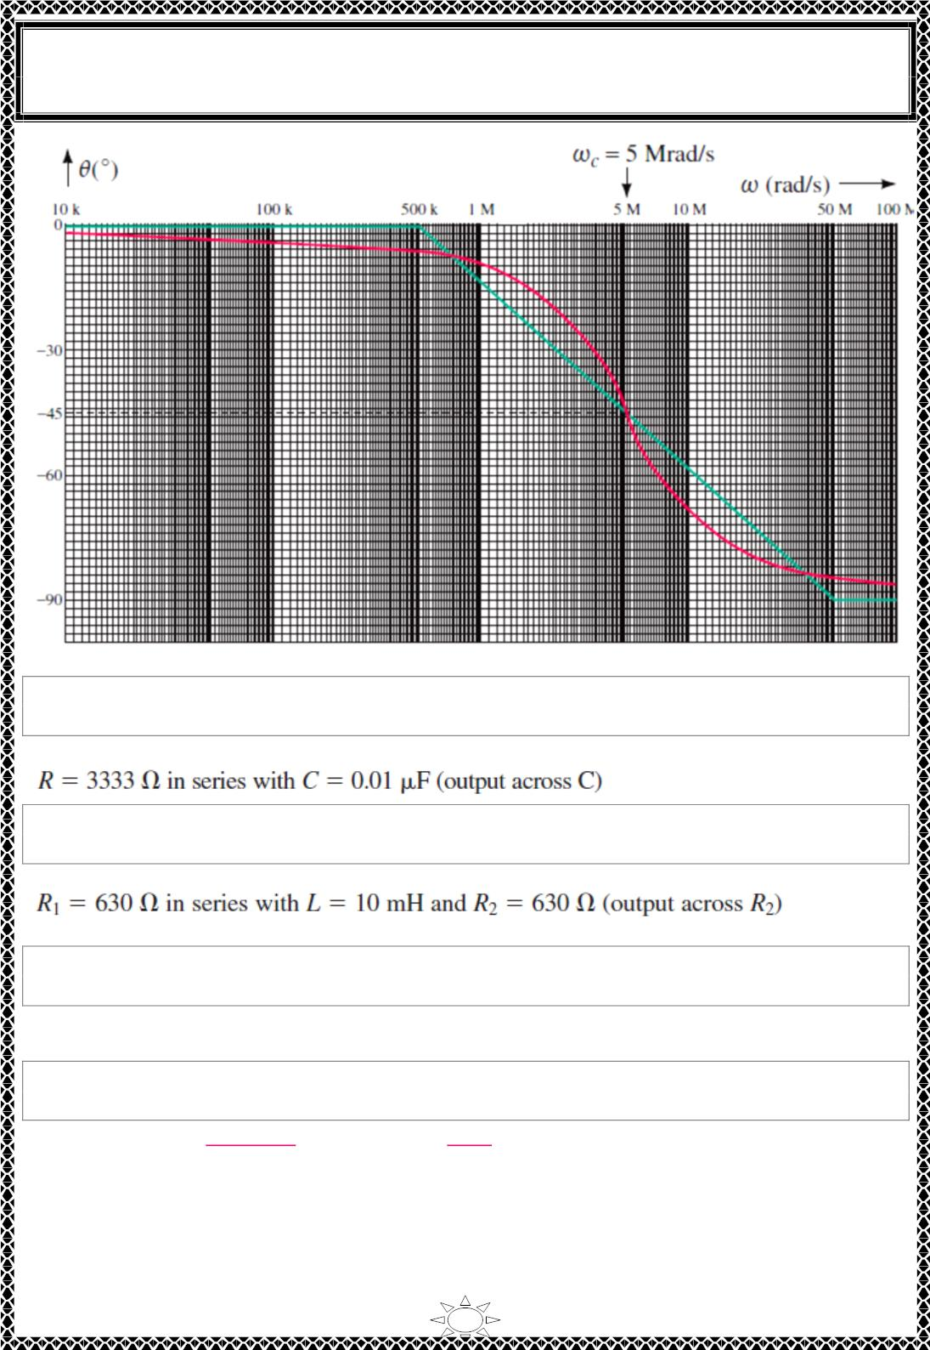
University of Diyala
Engineering College
Electronic Department
Electrical Circuits
2nd Class
Lecturer : Wisam N. AL-Obaidi
Year (2015-2016)
Trail Version
Trail Version
Trail Version
Trail Version
Trail Version
Trail Version
Trail Version
Trail Version
Trail Version
Trail Version
Trail Version
Trail Version
Trail Version
H.W. : Design a low-pass RC filter to have a cutoff frequency of 30 krad/s. Use a 0.01-
µF capacitor.
Answer:
H.W. : Design a low-pass RL filter to have a cutoff frequency of 20 kHz and a dc gain of
-6 dB. Use a 10-mH inductor. (Assume that the inductor has no internal resistance.)
Answer:
H.W. : A series RL low-pass filter with a cutoff frequency of 2 kHz is needed. Using
R = 5 kΩ, compute (a) L; (b) |퐻(푗휔)|at 50 kHz; and (c)휃(푗휔) at 50 kHz.
Answer: (a) 0.4 H, (b) 0.04, (c) -87.71⁰
H.W. : Compute the transfer function of a series RC low-pass filter that has a load resistor
R_{L} in parallel with its capacitor.
Answer: 푯(풔) =
ퟏ/푹푪
풔+ퟏ/푲푹푪
풘풉풆풓풆 푲 =
^{퐑}푳
푹ꢀ퐑_{푳}
10

Slide 4
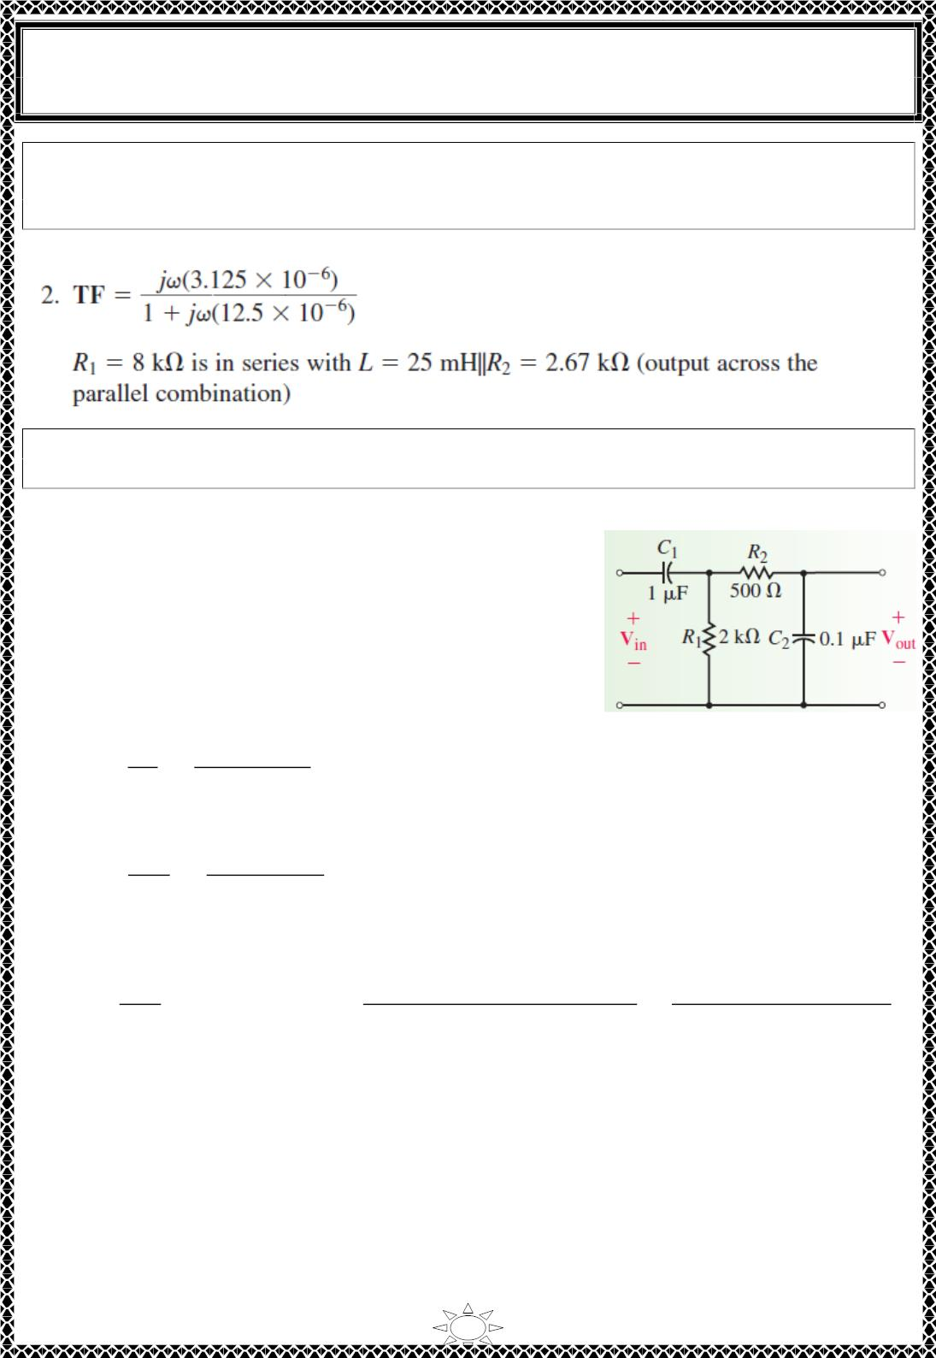
University of Diyala
Engineering College
Electronic Department
Electrical Circuits
2nd Class
Lecturer : Wisam N. AL-Obaidi
Year (2015-2016)
H.W. : Use a 25-mH inductor to design a high-pass filter circuit having a cutoff
frequency of 80 krad/s and a high-frequency gain of -12 dB. Sketch the frequency
response of the filter.
Answer:
Example : Write the transfer function for the circuit of Figure below. Sketch the
resulting Bode plot and determine the expected bandwidth for the band-pass filter.
Solution:
It is easier to recognize that the circuit consists of two
stages: one a low-pass stage and the other a high-pass
stage. If the cutoff frequencies of each stage are separated
by more than one decade, then we may assume that the
impedance of one stage will not adversely affect the
operation of the other stage. Based on the previous
assumption, the transfer function of the first stage is
determined as
Trail Version
Trail Version
Trail Version
Trail Version
Trail Version
Trail Version
Trail Version
Trail Version
Trail Version
Trail Version
Trail Version
Trail Version
Trail Version
푉
푗휔푅₁퐶₁
ꢀ + 푗휔푅₁퐶₁
퐻₁(휔) =
1
=
푉
푖푛
And for the second stage,
푉
ꢀ
퐻₂(휔) =
표푢푡
=
푉
ꢀ + 푗휔푅₂퐶₂
1
Combining the preceding results, we have
푉
푗휔푅₁퐶₁
푗휔휏₁
퐻(휔) =
표푢푡
= 퐻 (휔)퐻 (휔) =
=
푉
1
2
(ꢀ + 푗휔푅 퐶 )(ꢀ + 푗휔푅 퐶 ) (ꢀ + 푗휔휏 )(ꢀ + 푗휔휏 )
푖푛
1
1
2
2
1
2
11

Slide 5
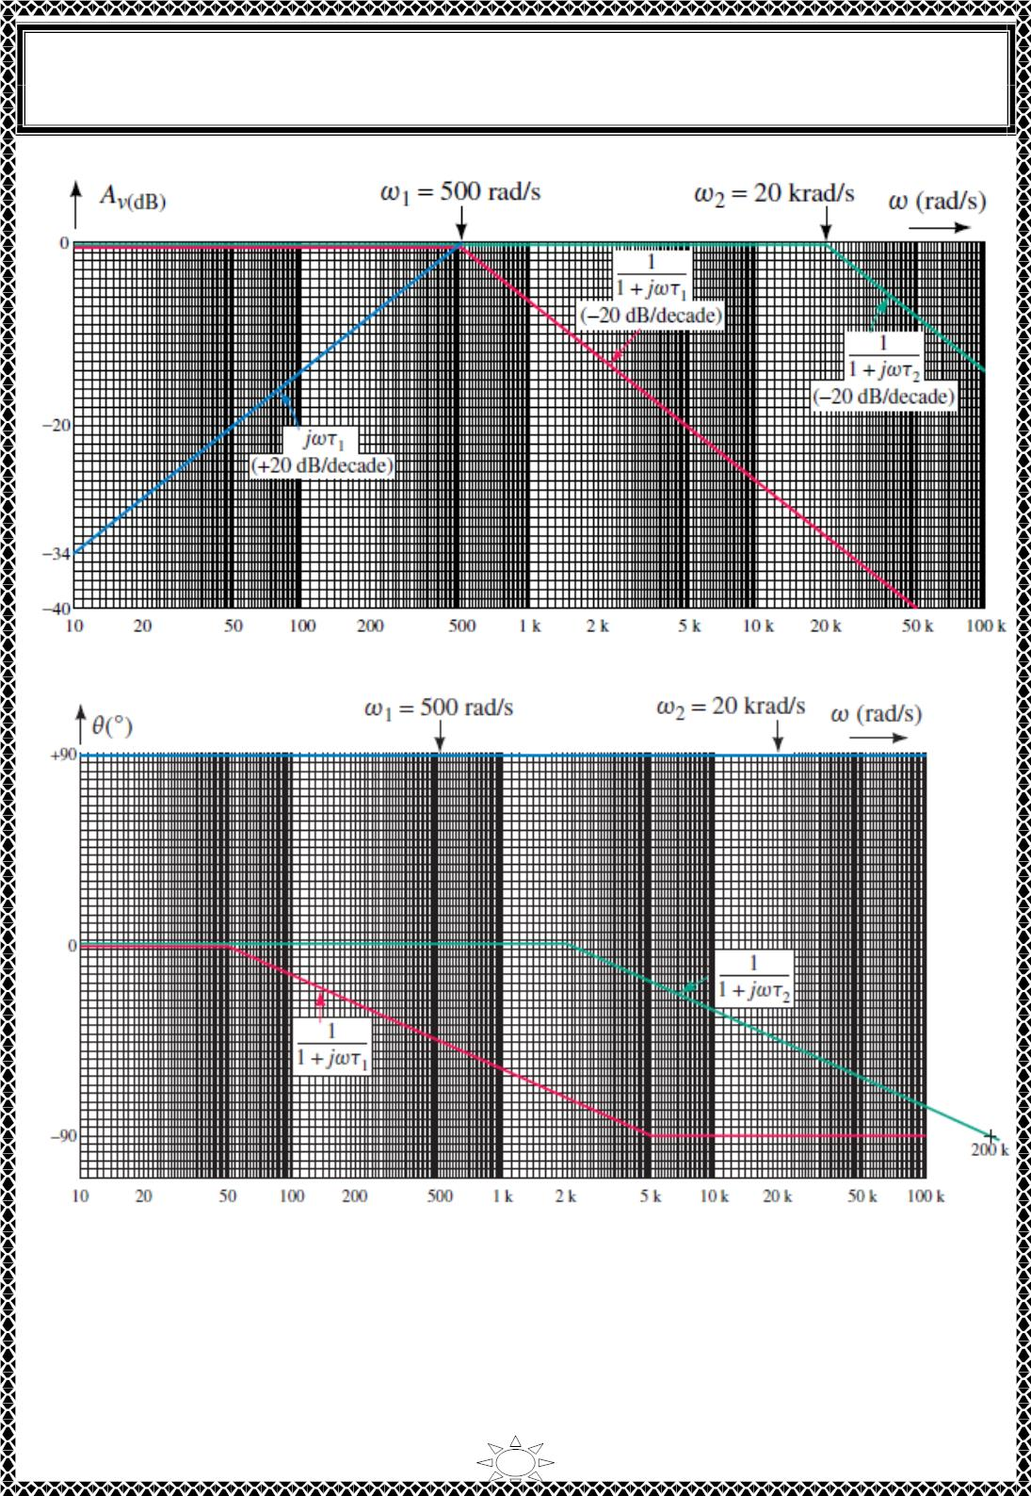
University of Diyala
Engineering College
Electronic Department
Electrical Circuits
2nd Class
Lecturer : Wisam N. AL-Obaidi
Year (2015-2016)
Trail Version
Trail Version
Trail Version
Trail Version
Trail Version
Trail Version
Trail Version
Trail Version
Trail Version
Trail Version
Trail Version
Trail Version
Trail Version
The resulting frequency response is determined by the summation of the individual
responses as shown in Figure below.
12

Slide 6
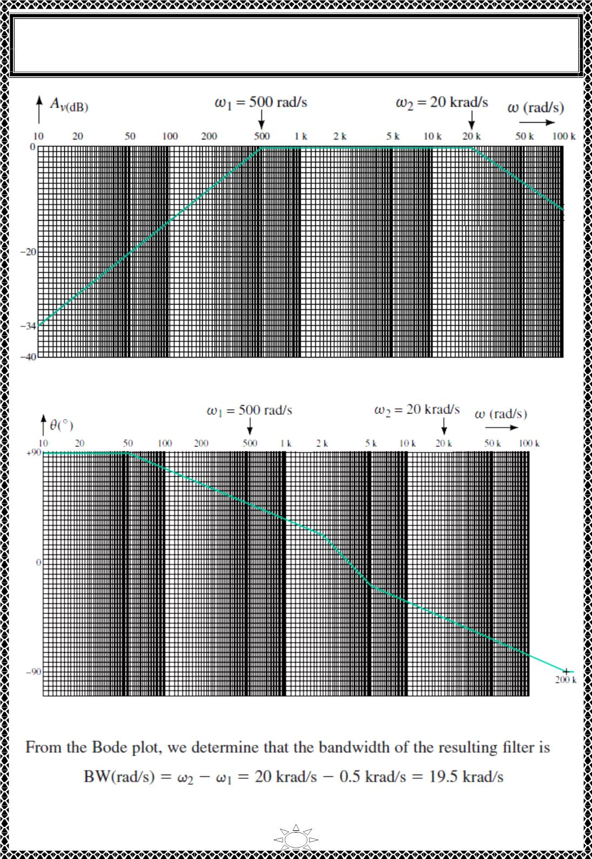
University of Diyala
Engineering College
Electronic Department
Electrical Circuits
2nd Class
Lecturer : Wisam N. AL-Obaidi
Year (2015-2016)
Trail Version
Trail Version
Trail Version
Trail Version
Trail Version
Trail Version
Trail Version
Trail Version
Trail Version
Trail Version
Trail Version
Trail Version
Trail Version
13

Slide 7
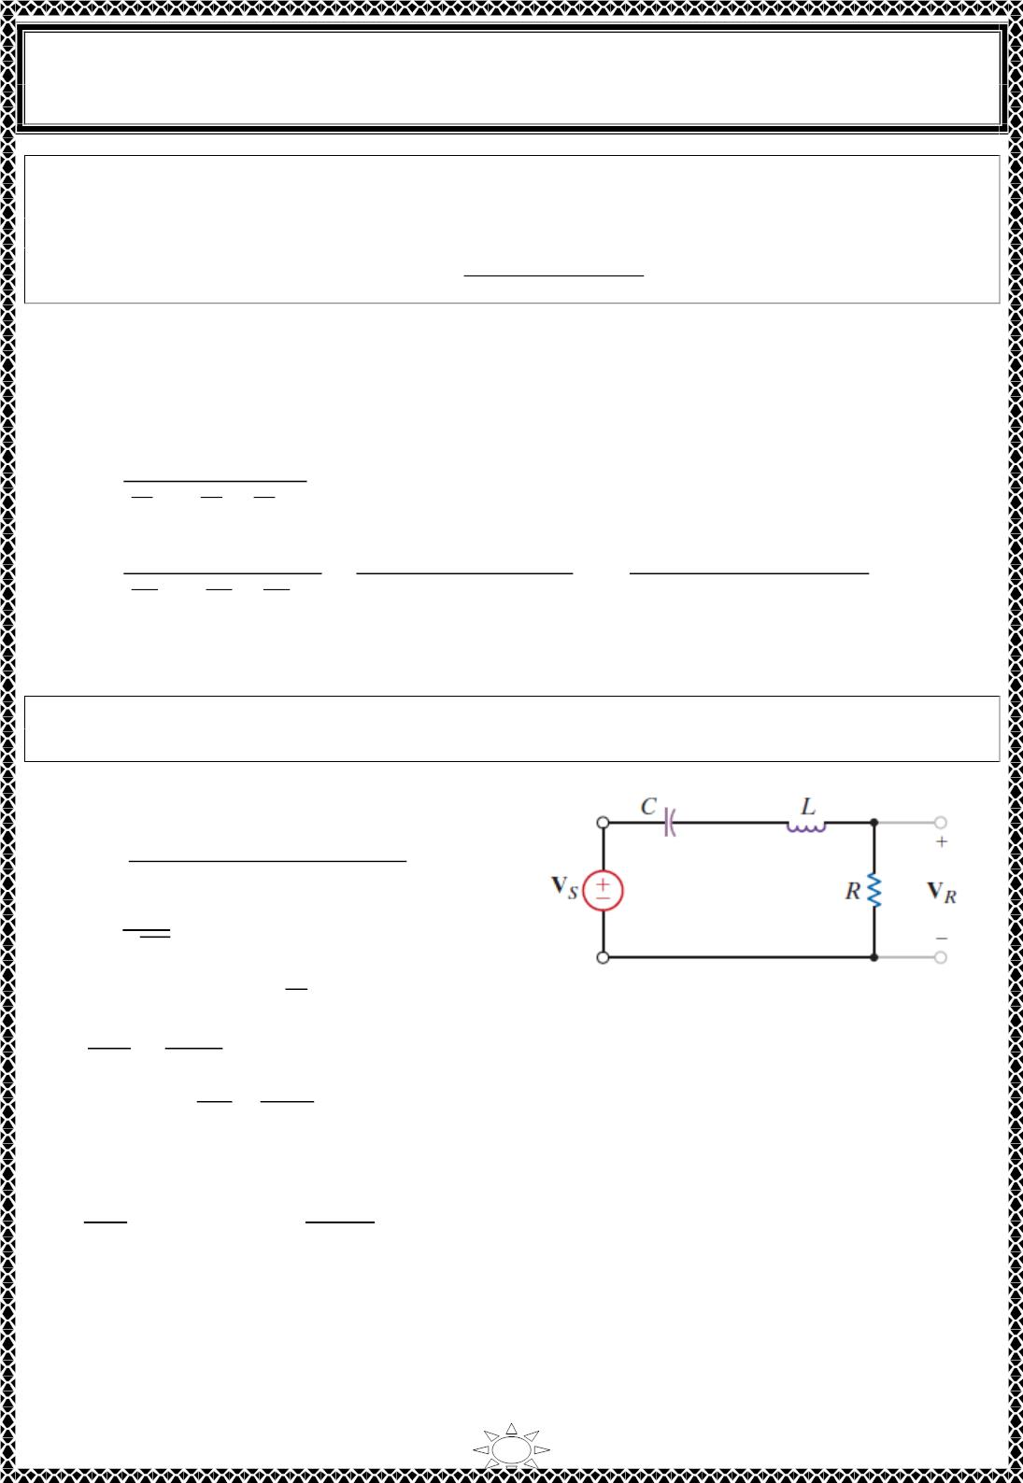
University of Diyala
Engineering College
Electronic Department
Electrical Circuits
2nd Class
Lecturer : Wisam N. AL-Obaidi
Year (2015-2016)
Example : Determine the transfer function of a third-order Butterworth low-pass filter
having a cutoff frequency equal to 500 rad/s, if the transfer function al cutoff frequency
equal 1 rad/s is given by,
퐻_{푛}(푠) =
1
Solution:
(푠 + 1)(푠² + 푠 + 1)
A technique called frequency scaling is used to adjust the cutoff frequency to 휔_{푐} =
500 푟푎푑/푠. Frequency scaling can be accomplished by replacing each 푠 in 퐻ꢀ(푠) by 푠/
휔_{푐}. That is,
퐻(푠) =
ꢁ
ꢂ
ꢂ
ꢂ
(_{ꢃ} ꢅꢁ)((_{ꢃ} )^{ꢆ}ꢅ_{ꢃ} ꢅꢁ)
ꢄ
ꢄ
ꢄ
In this case, 휔 = 500 푟푎푑/푠, so
퐻(푠) =
푐
ꢁ
ꢂ
=
ꢉꢊꢊ³
=
ꢁꢌꢉꢊꢊꢊꢊꢊꢊ
ꢂ
ꢇꢈꢈ
ꢂ
_{(ꢋꢅꢉꢊꢊ)(ꢋ}^{ꢆ}ꢅꢉꢊꢊꢋꢅꢉꢊꢊ^{ꢆ})
(ꢋꢅꢉꢊꢊ)(ꢋ^{ꢆ}ꢅꢉꢊꢊꢋꢅꢌꢉꢊꢊꢊꢊ)
(
ꢅꢁ)(( )^{ꢆ}ꢅ ꢅꢁ)
ꢇꢈꢈ
ꢇꢈꢈ
퐻(푠) is the transfer function of a third‐order Butterworth low‐pass filter having a cutoff
frequency equal to 500 푟푎푑/푠.
Trail Version
Trail Version
Trail Version
Trail Version
Trail Version
Trail Version
Trail Version
Trail Version
Trail Version
Trail Version
Trail Version
Trail Version
Trail Version
Example : We wish to determine the parameters R, L, and C so that the circuit shown in
Fig. operates as a band-pass filter with an 휔_{ꢊ} of 1000 rad/s and a bandwidth of 100 rad/s.
Solution:
The voltage gain for the network is
H(휔) =
(푅/퐿)푗휔
(푗휔)^{ꢌ} + (푅/퐿)푗휔 + 1/퐿퐶
1
∴ 휔_{ꢊ} =
√퐿퐶
ꢍ
ꢁ
= 10⁶
= 10
and since 휔 = 10 ,
휔_{ꢊ}
퐵푊
ꢊ
ꢎꢏ
푄 =
1000
=
100
= 10
ꢐ ꢎ
ꢁꢊꢊꢊꢎ
ꢑ
ꢈ
ꢑ
However, 푄 =
=
Note that we have two equations in the three unknown circuit parameters 푹, 푳, and 푪.
Hence, if we select 푪 = ퟏ흁푭, then
퐿 =
ꢁ
= 1퐻 and
ꢁꢊꢊꢊ(ꢁ)
ꢑ
= 10
ꢁꢊ^{ꢒ}ꢏ
∴ 푅 = 100훺
Therefore, the parameters 푅 = 100훺, 퐿 = 1퐻, and 퐶 = 1휇퐹 will produce the proper filter
characteristics.
14

Slide 8
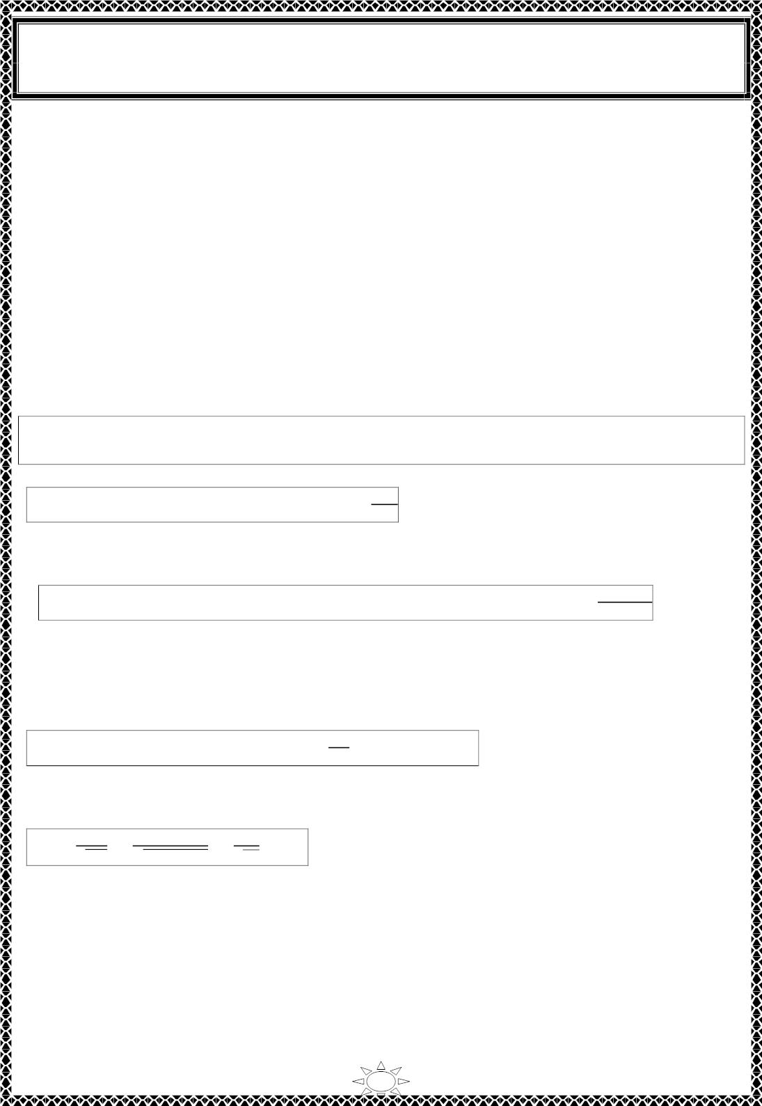
University of Diyala
Engineering College
Electronic Department
Electrical Circuits
2nd Class
Lecturer : Wisam N. AL-Obaidi
Year (2015-2016)
3) Scalling
In designing and analyzing filters and resonant circuits or in circuit analysis in general, it
is sometimes convenient to work with element values of 1 Ω, 1 H, or 1 F, and then
transform the values to realistic values by scaling. We have taken advantage of this idea by
not using realistic element values in most of our examples and problems; mastering circuit
analysis is made easy by using convenient component values. We have thus eased
calculations, knowing that we could use scaling to then make the values realistic.
There are two ways of scaling a circuit: magnitude or impedance scaling, and frequency scaling.
Both are useful in scaling responses and circuit elements to values within the practical
ranges. While magnitude scaling leaves the frequency response of a circuit unaltered,
frequency scaling shifts the frequency response up or down the frequency spectrum.
3.1) Magnitude Scalling
Magnitude scaling is the process of increasing all impedances in a network by a
factor, the frequency response remaining unchanged.
Recall that impedances of individual elements R, L, and C are given by
푍_{푅} = ꢀ.
푍_{퐿} = 푗휔ꢁ.
푧_{푐} =
1
…(3.1)
Trail Version
Trail Version
Trail Version
Trail Version
Trail Version
Trail Version
Trail Version
Trail Version
Trail Version
Trail Version
Trail Version
Trail Version
Trail Version
ꢂꢃ퐶
In magnitude scaling, we multiply the impedance of each circuit element by a factor K_{m}
and let the frequency remain constant. This gives the new impedances as
푍′ = 퐾 푍 = 퐾 ꢀ.
푍′ = 퐾 푍 = 푗휔퐾 ꢁ,
′
1
푚
푅
푚
푚
퐿
푚
푍 = 퐾 푍 =
…(3.2)
푅
퐿
퐶
푚 퐶
ꢂꢃ퐶/ꢄ_{ꢅ}
Comparing Eq. (3.2) with Eq. (3.1), we notice the following changes in the element
values: ꢀ → 퐾 ꢀ, ꢁ → 퐾 ꢁ, and ꢆ → ꢆ/퐾 . Thus, in magnitude scaling, the new values
푚
푚
푚
of the elements and frequency are
ꢀ′ = 퐾_{푚}ꢀ. ꢁ′ = 퐾_{푚}ꢁ,
퐶
ꢆ′ =
,
휔′ = 휔
…(3.3)
^{ꢄ}ꢅ
The primed variables are the new values and the unprimed variables are the old values.
Consider the series or parallel RLC circuit. We now have
ω′₀ =
1
=
1
1
√퐿’퐶’
=
= 휔₀
…(3.4)
ꢇꢄ_{ꢅ}퐿퐶/ꢄ_{ꢅ}
√퐿퐶
showing that the resonant frequency, as expected, has not changed. Similarly, the quality
factor and the bandwidth are not affected by magnitude scaling. Also, magnitude scaling
does not affect transfer functions in the forms of Eqs. (2.2a) and (2.2b) in previous lecture,
which are dimensionless quantities.
15

Slide 9
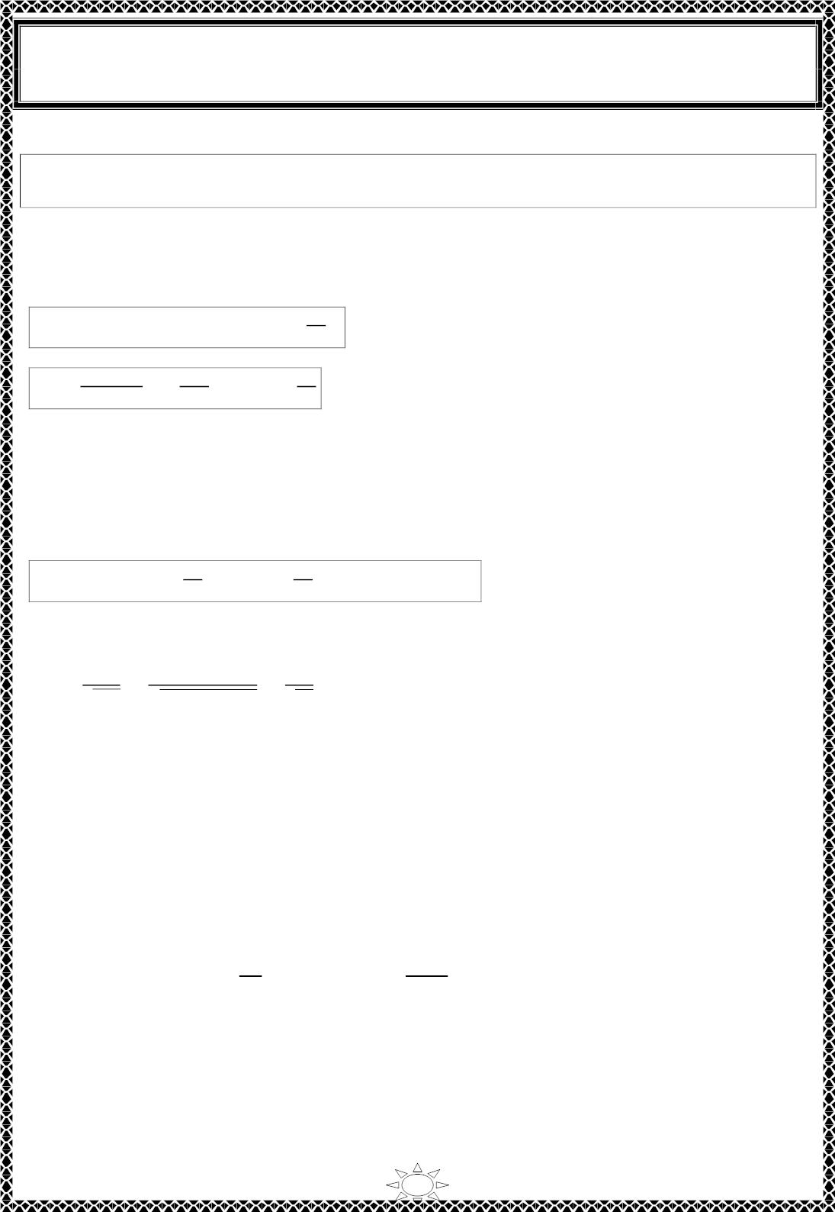
University of Diyala
Engineering College
Electronic Department
Electrical Circuits
2nd Class
Lecturer : Wisam N. AL-Obaidi
Year (2015-2016)
3.2) Frequency Scalling
Frequency scaling is the process of shifting the frequency response of a network
up or down the frequency axis while leaving the impedance the same.
We achieve frequency scaling by multiplying the frequency by a factor K_{f} while keeping
the impedance the same.
From Eq. (3.1), we see that the impedances of L and C are frequency-dependent. If we
apply frequency scaling to 풁 (흎) and 풁 (흎)in Eq. (3.1), we obtain
푳
퐿
푪
푍 = 푗(휔퐾 )ꢀ′ = 푗휔ꢀ ⇒ ꢀ′ =
…(3.5a)
퐿
푓
ꢁ_{ꢂ}
1
1
퐶
푍_{퐶} =
ꢃ(ꢄꢁ_{ꢂ})퐶
ꢅ =
⇒ ꢆ′ =
…(3.5b)
ꢃꢄ퐶
ꢁ_{ꢂ}
since the impedance of the inductor and capacitor must remain the same after frequency
scaling. We notice the following changes in the element values: ꢀ → ꢀ/퐾 and ꢆ → ꢆ/퐾 .
푓
푓
The value of 푅 is not affected, since its impedance does not depend on frequency. Thus, in
frequency scaling, the new values of the elements and frequency are
Trail Version
Trail Version
Trail Version
Trail Version
Trail Version
Trail Version
Trail Version
Trail Version
Trail Version
Trail Version
Trail Version
Trail Version
Trail Version
푅′ = 푅.
퐿
퐶
ꢀ′ = ,
ꢆ′ = ,
휔′ = 퐾_{푓}휔
…(3.6)
ꢁ
ꢁ
ꢂ
ꢂ
Again, if we consider the series or parallel RLC circuit, for the resonant frequency
ω′₀ =
1
=
1
ꢁꢂ
√퐿’퐶^{ꢇ}
ꢈ(퐿/ꢁ )(퐶/ꢁ )
=
= 퐾_{푓}휔₀
…(3.7)
…(3.8)
ꢂ
ꢂ
√퐿퐶
and for the bandwidth
퐵′ = 퐾_{푓}퐵
but the quality factor remains the same (푄ꢅ = 푄) .
3.3) Magnitude and Frequency Scaling
If a circuit is scaled in magnitude and frequency at the same time, then
푅′ = 퐾_{푚}푅.
ꢁꢉ
ꢁ_{ꢂ}
1
ꢀ′ =
ꢀ,
ꢆ′ =
ꢁ_{ꢉ}ꢁ_{ꢂ}
ꢆ.
휔′ = 퐾_{푓}휔
…(3.9)
These are more general formulas than those in Eqs. (3.3) and (3.6). We set K_{m} = 1 in Eq.
(3.9) when there is no magnitude scaling or K_{f} = 1 when there is no frequency scaling.
16

Slide 10
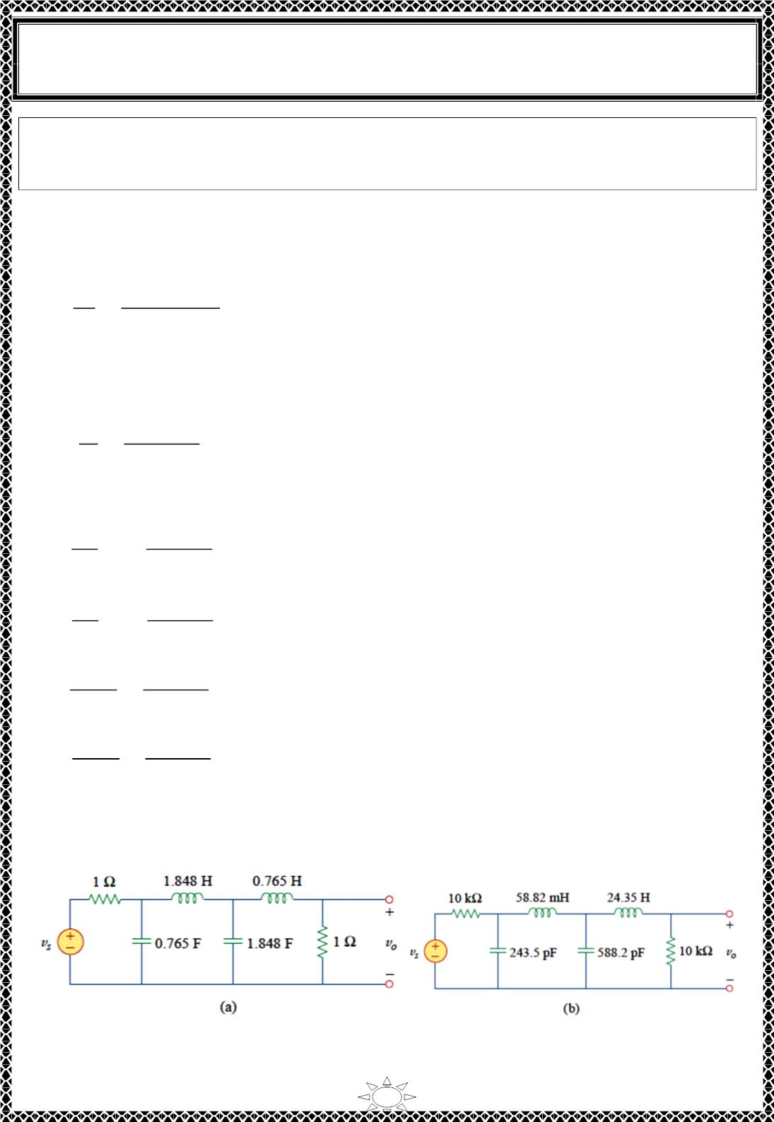
University of Diyala
Engineering College
Electronic Department
Electrical Circuits
2nd Class
Lecturer : Wisam N. AL-Obaidi
Year (2015-2016)
Example 3: A fourth-order Butterworth lowpass filter is shown in Fig.(a). The filter is
designed such that the cutoff frequency 흎_{풄} = ퟏ rad/s. Scale the circuit for a cutoff
frequency of 50 kHz using 10- kΩ resistors.
Solution:
If the cutoff frequency is to shift from 휔_{푐} = 1푟푎푑/푠 to 휔_{푐}^{′ = 2휋(50) 푘푟푎푑/푠}, then the
frequency scale factor is
휔′
100휋 × 10³
1
퐾_{푓} =
푐
= 휋 × 10ꢀ
=
휔_{푐}
Also, if each 1 훺 resistor is to be replaced by a 10 푘훺 resistor, then the magnitude scale
factor must be
퐾 =
푚
푅′ 10 × 10³
= 10⁴
푅
=
1
Using Eq. (3.9),
Trail Version
Trail Version
Trail Version
Trail Version
Trail Version
Trail Version
Trail Version
Trail Version
Trail Version
Trail Version
Trail Version
Trail Version
Trail Version
퐿′ꢁ =
퐿′_{ꢄ} =
퐶í =
퐶_{ꢄ}′ =
퐾_{푚}
퐾
푓
퐿ꢁ =
퐿_{ꢄ} =
=
10⁴
휋 × 10ꢀ
(1 ∙ 8ꢂ8) = 58.82ꢃ퐻
퐾_{푚}
퐾
푓
10⁴
휋 × 10ꢀ
(0 ∙ 765) = 2ꢂ ∙ ꢅ5ꢃ퐻
= 2ꢂꢅ ∙ 5푝퐹
퐶ꢁ
퐾 퐾
푚
0.765
휋 × 10⁹
푓
퐶_{ꢄ}
퐾 퐾
1.8ꢂ8
휋 × 10⁹
푚
푓
=
= 588 ∙ 2푝퐹
The scaled circuit is shown in Fig.(b). This circuit uses practical values and will provide
the same transfer function as the prototype in Fig.(a), but shifted in frequency.
17

